Slide 1
Corona virus analysis

Slide 2
agenda
By using SQL we are going to find number of
Deaths,Confirmed and Recovered.

Slide 3

What is sql?
Structured query language (SQL) is a programming language for storing and processing information in a relational database. A relational database stores information in tabular form, with rows and columns representing different data attributes and the various relationships between the data values

Slide 4
Corona analysis?
USE TASK1;
SELECT * FROM TASK1;
SELECT*FROM TASK1WHERE CONFIRMED IS NULL;
Start and end dates
MIN(start_date) AS earliest_start_date,
MAX(end_date) AS latest_end_date;
Maximum values of confirmed, deaths, recovered per year
MAX(confirmed) AS max_confirmed,
MAX(deaths) AS max_deaths,
MAX(recovered) AS max_recovered;

Slide 5

SQL Query.
The SELECT statement is the foundational tool for SQL for data analysis. It allows you to retrieve specific data from a database table, including specific columns, rows, or calculated values. TheFROM statement specifies the location or table from which the data needs to be retrieved.

Slide 6
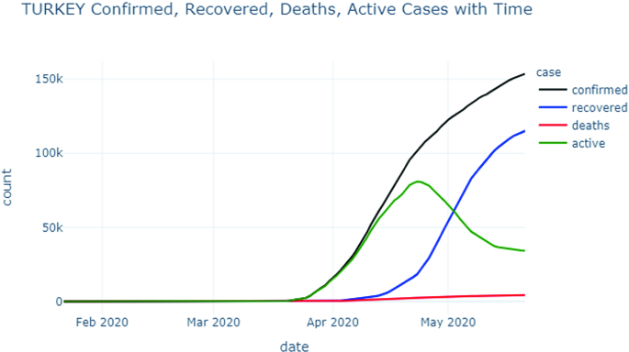
Graphical representation

Slide 7
Thank you
By Gunda Minnu.

